Slide 1
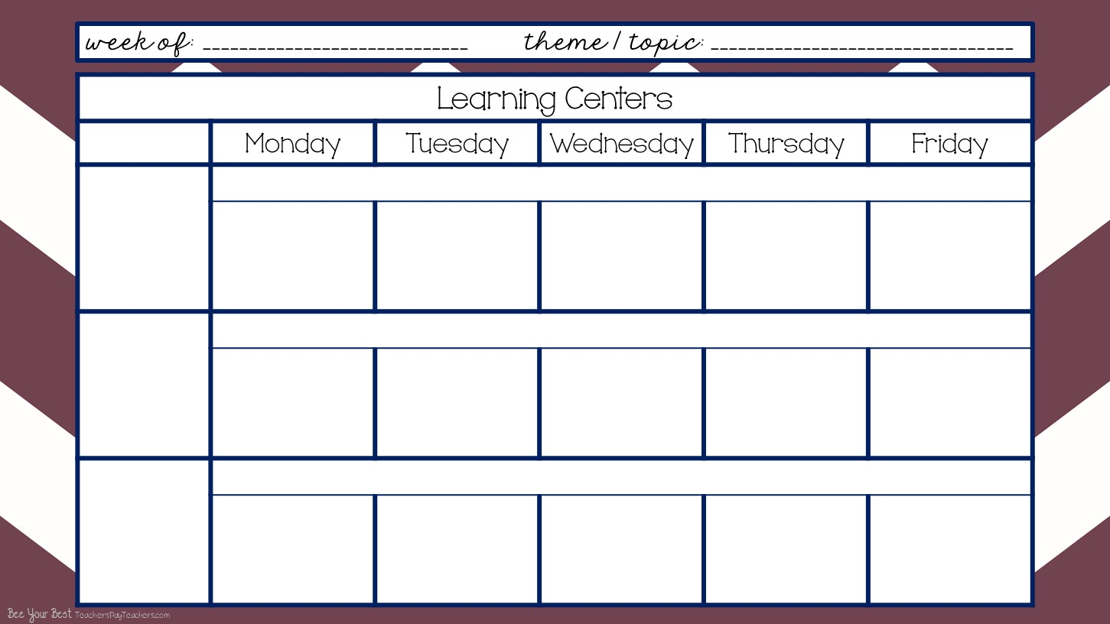
Wk# 1 -- Aug. 17-21, 2020
The Kissing Hand; Rules & Routines; Health & Safety
Arrival & Free Play
8:40-9:40
I can become more independent. I can recognize and find my name and cubby. I can put my stuff away. I can choose an activity and friends to play with.
Enter text here
Enter text here
Enter text here
Enter text here
Enter text here
Clean Up
9:40-9:45
I can work with my friends and clean up and put things away then come to the carpet and get ready to learn altogether.
Community Carpet Time
9:45-10:10
I can sit on my spot on the carpet. I can listen to my teacher. I can keep my hands to myself. I can participate and learn.
Come to the Carpet
Criss Cross Applesauce
Dr. Jean’s Rules Rap
Learn Letter Sounds A-Z
1-2 Buckle My Shoe
Come to the Carpet
Criss Cross Applesauce
Dr. Jean’s Rules Rap
Learn Letter Sounds A-Z
1-2 Buckle My Shoe
I’m a Little Teapot
Come to the Carpet
Criss Cross Applesauce
Dr. Jean’s Rules Rap
Zoo Phonics with flashcards
Hickory DIckory Dock
Hey DIddle Diddle
Come to the Carpet
Criss Cross Applesauce
Dr. Jean’s Rules Rap
Go Letters Dr. Jean
Hickory DIckory Dock
Hey Diddle Diddle
Come to the Carpet
Criss Cross Applesauce
Dr. Jean’s Rules Rap
Go Letters Dr. Jean
1-2 Buckle My Shoe
I’m a Little Teapot

Slide 2
Wk# -- , 2020
Morning Recess
10:10-10:40
I can play with my friends and share the equipment. I can play on the equipment correctly. I can line up when it’s time to go in.
Outside on Playground
(if there’s inclement weather then do rainy day boxes inside the classroom)
Mini Lessons
10:40-10:55
I can listen, learn, and participate in mini literacy, math, social skills, science, and social studies lessons.
Mini Literacy Lesson
Read Aloud
Class Discussion
Mini Math Lesson
Mini Literacy Lesson
Name of the Day
Mini Social Skills Lesson + Class Discussion / Anchor Chart
Mini Science / Social Studies Lesson -- use Weekly Reader + Class Discussion
Lunch
11:00-11:30 Afternoon Recess
11:30-noon
I can eat lunch and clean up my mess when I’m done. I can line up and walk to and from lunch and recess. I can keep my hands to myself and be nice to my neighbors.
Cafeteria & Outside on Playground
(if there’s inclement weather then do rainy day boxes inside the classroom)

Slide 3
Wk# -- 2020
...
Smart Board Activity
noon-12:45
I can enjoy engaging Smart Board Activities while cooling down or warming up from being at recess. I will go to the bathroom and wash my hands. I will participate in smart board activities.
Review ABCs with Sesame Street song
The Singing Walrus Shapes Song
Pick a Shape Game
Color Word Songs as many as we can fit it!
Color Monster Game
The Numeral Song with “air writers”
Who Took the Cookies from the Cookie Jar Name Activity
Work Stations / Center Rotations with Buddy
12:15-1:15
I can work with my work station buddy. I can share and communicate. I can clean up. I can put my papers away. I can learn the chart and move around. I can follow instructions. I can learn and grow!
Library -2- Thematic Unit Books
Shannon -4- Monday - PK Hat
Tuesday - Handprint Raccoon Poem
NO Work Stations because it’s Early Out Day
Library -2- Thematic Unit Books
Shannon -4- Thursday Welcome Color Sheet
Friday - Handprint Memory Poem
Work Stations cont’d.
Math -2- Sort Colored People Manipulatives with Numbers on them
Literacy -2- Trace the Bus & Color
NO Work Stations because it’s Early Out Day
Math -2- Counting & Coloring with Chester
Literacy -2- Trace the R for Racoon & Color

Slide 4
Wk# -- 2020
...
Work Stations cont’d.
Home & Living -4- Play & Pretend
Blocks -2- Build & Create
NO Work Stations because it’s Early Out Day
Home & Living -4- Play & Pretend
Blocks -2- Build & Create
Work Stations cont’d.
Teacher Table -2- Journal Self Portraits
BIG Carpet -2- BIG Bus Puzzle
NO Work Stations because it’s Early Out Day
Teacher Table -2- Story Telling with ABC Soft Blocks
BIG Carpet -2- BIG Bus Puzzle or Light Box with Legos
Afternoon Snack
1:15-1:30
I can eat and drink at snack time. I can wash up before and after snack. I can toss my trash.
Wash Up -- Eat & Drink -- Clean Up & Toss Trash

Slide 5
Wk# -- 2020
Pack Up & Get Ready to Go Home Daily Review
1:30-1:55
I can pack up my backpack and put on my jacket. I can sit on my square on the carpet and be kind to my neighbors. I can listen and learn.
Dismissal
2:00-2:30
I can line up and follow instructions of where to go and what to do from my teachers. I can be happy to go home!
Teacher Planning
2:30-3:40
I can plan awesome opportunities to learn and grow and be flexible as changes inevitably come.
PK
Grade Level
Mtg.

